Slide 1
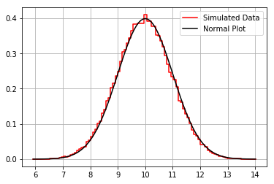
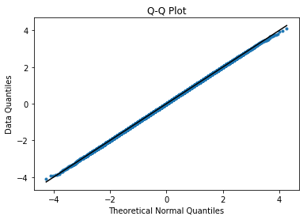
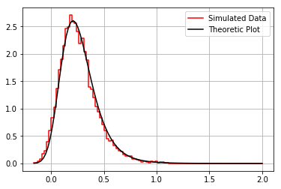
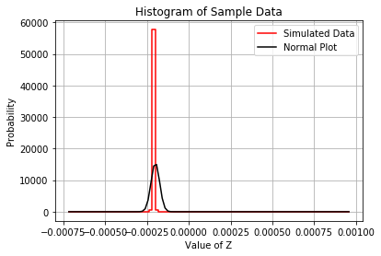
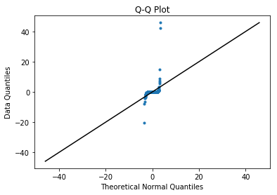
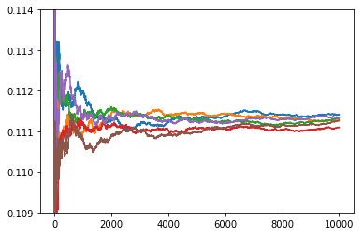
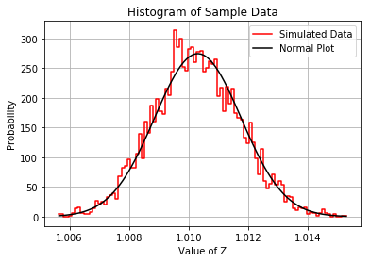
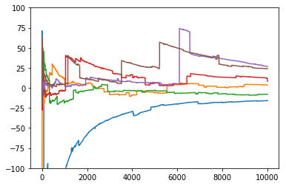
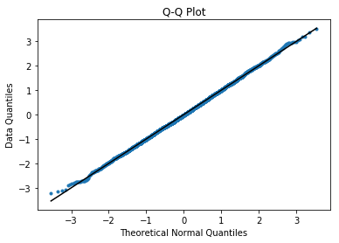



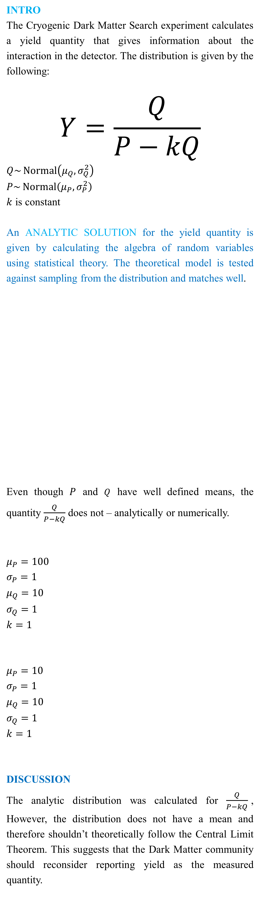
For normally distributed variables P and Q, the quantity $\frac{Q}{P−kQ}$ is analytically calculable and can behave pathologically.
Title: Mathematical Distributions for Dark Matter Detection
Non-Cognitive Predictors of Student Success: A Predictive Validity Comparison Between Domestic and International Students
The CENTRAL LIMIT THEOREM states that sometimes the sum of independent random variables tends to a normal distribution, even when the original distribution was not normal. This implies that the sample mean is distributed normally for certain distributions.
RESULTS
A Normal Distribution, when tested for normality, has the following graphical results on a histogram and a Q-Q Plot.
These are the
expected results
of normally
distributed data.
The yield distribution is numerically tested against the Central Limit Theorem using sampling.
This shows that
the sample means
aren’t normally
distributed,
meaning that
the yield
distribution
doesn’t follow the
Central Limit Theorem.
The yield distribution seems to follow the central limit theorem with certain parameters and finite sample size.
This shows the
sample mean data
seeming very
Normal from the
Histogram and
Q-Q Plot,
suggesting that the
distribution could follow the Central Limit Theorem.
Arvind Srinivasan
INTRO
The Cryogenic Dark Matter Search experiment calculates a yield quantity that gives information about the interaction in the detector. The distribution is given by the following:
$$Y=\frac{Q}{P−kQ}$$
$Q\sim \operatorname{Normal}\left(μ_{Q},σ_{Q}^{2}\right)$
$P\sim \operatorname{Normal}\left(μ_{P},σ_{P}^{2}\right)$
$k$ is constant
An ANALYTIC SOLUTION for the yield quantity is given by calculating the algebra of random variables using statistical theory. The theoretical model is tested against sampling from the distribution and matches well.
Even though $P$ and $Q$ have well defined means, the quantity $\frac{Q}{P−kQ}$ does not – analytically or numerically.
$μ_{P}=100$
$σ_{P}=1$
$μ_{Q}=10$
$σ_{Q}=1$
$k=1$
$μ_{P}=10$
$σ_{P}=1$
$μ_{Q}=10$
$σ_{Q}=1$
$k=1$
DISCUSSION
The analytic distribution was calculated for $\frac{Q}{P−kQ}$, However, the distribution does not have a mean and therefore shouldn’t theoretically follow the Central Limit Theorem. This suggests that the Dark Matter community should reconsider reporting yield as the measured quantity.
Probability
Yield
Running Mean
Sample Size
Running Mean
For details on the analytic solution
https://osf.io/hb89p/
Sample Size
Notes:
Notes:
In Powerpoint, click View > Guides
Keep text within gutter guides.
Author list: Don’t split names onto two lines (e.g., “Jimmy [break] Smith”). If that happens, use a new line, unless you need the space. Bold the first names of anybody who’s presenting in person.
Intro/methods/result: Do not drop below font size 28, but if you have extra space, jack up the font size until the space is full.
Do not use color in the sidebars except in graphs/figures. It’ll pull attention from the center and slow interpretation for passersby.

